Slide 1
RAMP Budget Entry
October 1, 2026

Slide 2
Optional RAMP Budget Entry
An abbreviated budget entry can be completed when a different budget calculation method is preferred or required by funding agency.
  NSF Proposal
  Budget Template Required by Agency
A detailed budget will be required in the Attachments section of the RAMP Funding Proposal.

Slide 3
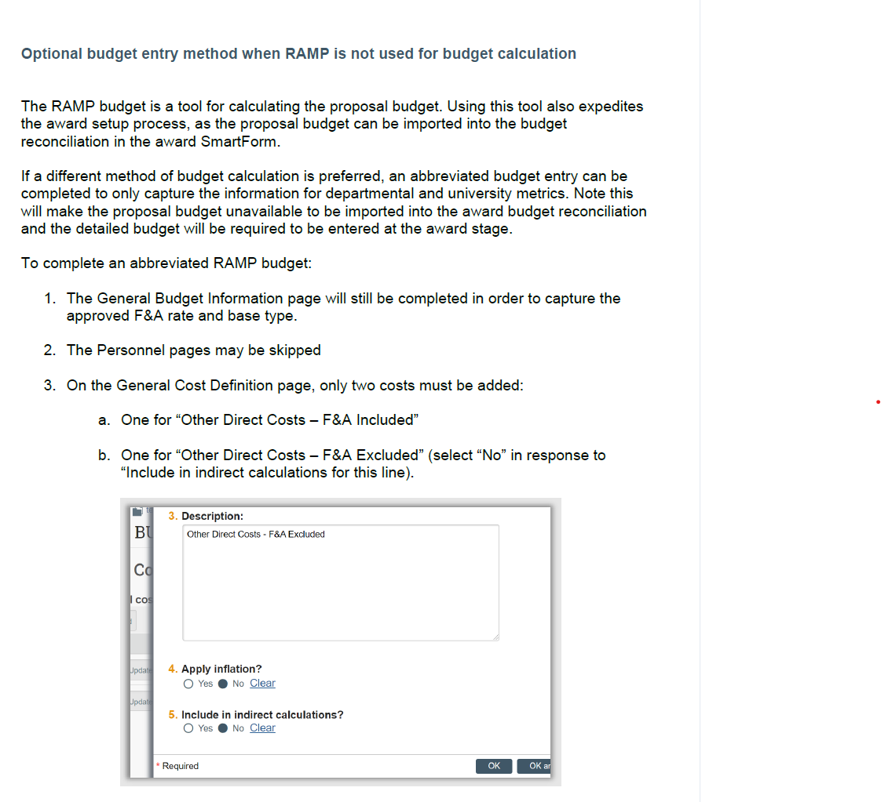
Optional RAMP Budget Entry
RAMP How-To-Guide
How to Create a Proposal Budget
Examples:
Salaries, Supplies, Travel, etc.
Tuition, Equipment, etc.

Slide 4
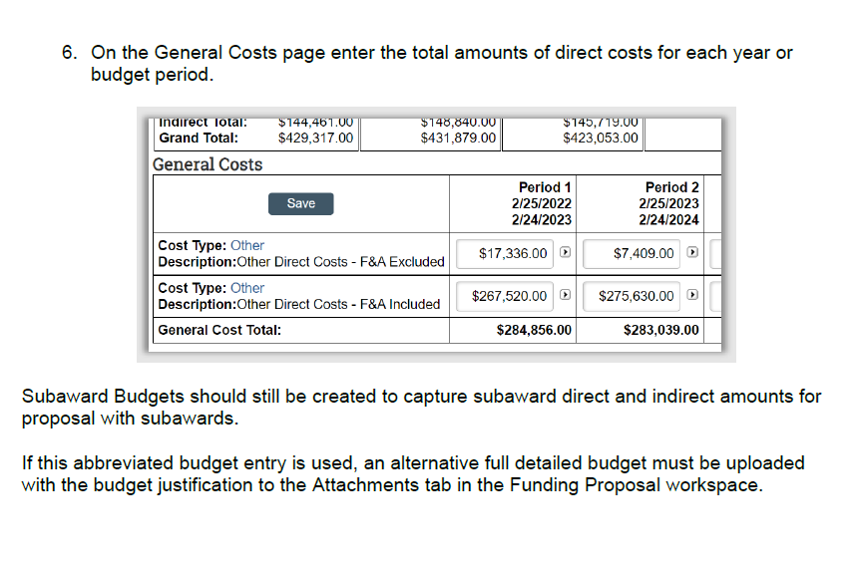
Optional RAMP Budget Entry
Budget Periods
Manually Enter the total budget amounts per year for Excluded and Included Costs

Slide 5
Questions??

